Slide 1
EduNLP: A Rule-Based Multilingual Smart Education System for Rural Learning
CSE7101- Capstone Project
Review-3
Batch Number: CSE_94
Under the Supervision of,
Dr. Prema Arokia Mary G
Associate Professor
School of Computer Science and Engineering
Presidency University
Roll Number | Student Name
20221CSE0484 | K SAI SRI
20221CSE0446 | MEGHANA K
20221CSE0061 | SHAIK MOHAMMED IMRAN
Name of the Program: B.Tech, Computer Science and Engineering
Name of the HoD: Dr. Blessed Prince
Name of the Program Project Coordinator: DR. MUTHURAJU V
Name of the School Project Coordinators: Dr. Sampath A K , Dr. Geetha A

Slide 2
Content
Problem Statement
Objectives
Background and Related work for title Selection
Architecture Diagram
Modules
Algorithms
Hardware nd Software Requirements
Innovation or Novel Contributions
Git-hub Link
Timeline of the Project
Result
References

Slide 3
Problem Statement
Problem Statement Number: PSCS_32
Organization: Government of Kerala
Category: Software
Problem Description: Ideate and implement a system to enhance the quality of education in rural areas.
The aim of the system should not only focus on increasing the literacy rate but also
should assist to elevate the communication skills and knowledge of the targeted
society.

Slide 4
Objectives
Provide study materials in local languages for rural students.
Track each student’s learning progress and skills.
Share information about scholarships, grants, and job opportunities.

Slide 5
Background and Related work
In India, several government and non-government initiatives have tried to improve rural education. The Diksha platform offers free digital content for students and teachers, and SWAYAM provides online courses from top institutions. While these platforms are valuable, they depend on good internet connectivity and are often limited to a few languages, making them less effective in remote rural areas.
A national review by ITU indicates that even though digital tools and local content help, manyrural areas still struggle with connectivity, language barriers, and teacher training.
NGOs such as Pratham have worked to improve literacy rates through community-based programs, and Room to Read India has focused on enhancing reading skills and building school libraries. These efforts have made progress in increasing enrolment and basic literacy, but many rural students still struggle to access personalized learning, continuous mentorship, and career-related resources.
Government schemes like Samagra Shiksha Abhiyan and PM e-Vidya aim to strengthen school infrastructure and promote digital education, yet gaps remain in implementation, especially in areas with low internet speed, poor teacher training, and lack of local-language learning materials.
Our project builds on these efforts by combining multiple features like digital learning resources in local languages, mentorship, progress tracking, and access to scholarships and job opportunities into a single platform designed specifically for rural learners in India.

Slide 6
Background and Related work(contd...)
AUTHOR | YEAR | TITLE | METHODOLOGY | INFERENCE
Ojat Darojat, Ajat Sudrajat, Darsiharjo, Lisa Dwi Ningtyas, Cecep Kustandi | 2025 | Learning Media Use in Rural | Mixed-method, GWT ANOVA | Flipped classroom w/ downloads best for low connectivity.
Ayesha Zulfiqar, Muhammad Bilal, Muhammad Nadeem Iqbal | 2024 | Factors Affecting Rural Schools | Quantitative survey | Facilities, teaching quality, poverty strongly impact outcomes.
Chaoyang Wang | 2024 | Rural Edu. Reform | Policy & case analysis | Focus: student autonomy, teacher training, infrastructure.
Radhika Kapur | 2024 | Education in Rural India | Qualitative descriptive | Fix infra, recruit teachers, improve methods/resources.
K.S. Suryanarayana, V.S. Prasad Kandi, G. Pavani, Akuthota Sankar Rao, Sandeep Rout, T. Siva Rama Krishna | 2024 | AI-Enhanced Learning Mgmt | AI system design | Personalized learning, analytics aid sustainability; privacy concerns.

Slide 7
Background and Related work(contd...)
AUTHOR | YEAR | TITLE | METHODOLOGY | INFERENCE
Yang Yu, Desmond Appiah, Bernard Zulu, and Kofi Asamoah AduPoku | 2024 | Integrating Rural Dev., Edu. & Mgmt | Literature review | Community participation + tech → sustainable rural development.
Xining Wang,Gareth W. Young,Muhammad Zahid Iqbal,Conor Mc Guckin | 2024 | XR in Rural Education | Workshop + focus groups | XR seen as transformative for vocational & contextual learning.
Dr. Prem Das Maheshwari | 2024 | Digital Intervention NEP 2020 | Policy/feature analysis | Digital infra + local content → bridge rural divide; but poor connectivity persists.
Muhammad Tahir Khan Farooqi ,Ishaq Amanat ,Muhammad Awan | 2024 | AI Ethics in Education | Systematic review | AI → privacy risks, teacher resistance; need training & safeguards.
Ying Lin, Northern Arizona | 2024 | Computer Networks in Distance Edu. | Conceptual analysis | Strong network infra vital for high-quality distance learning.

Slide 8
Background and Related work(contd...)
AUTHOR | YEAR | TITLE | METHODOLOGY | INFERENCE
Yuling Sun, Xiuqi Zhu, Xiaomu Zhou, Bingsheng Yao, Kai Zhang, Dakuo Wang, Jiaju Chen, Liang He | 2025 | ICT in Rural China | Qualitative interviews & obs. | Remote classes work if local teachers contextualize content.
Salam Michael Singh, Shubhmoy Kumar Garg, Amitesh Misra, Aaditeshwar Seth, Tanmoy Chakraborty | 2024 | SUKHSANDESH AI Sexual Edu. | Platform proposal | AI avatars break stigma; need safety & language localization.
Te-Hsin Hsieh & Xueye Lai | 2024 | ML for Rural Talent Dev. | RF & XGBoost analysis | ML predicts adaptability; supports scalable training.
Multiple authors | 2024 | Gen-AI in Rural Teaching | Analytical review | Gen-AI personalized learning but infra gaps hinder adoption.
Arihant Bardia & Aayush Agrawal | 2024 | MindCraft AI Learning | System design | AI personalization + mentorship + low bandwidth support helps rural learners.

Slide 9
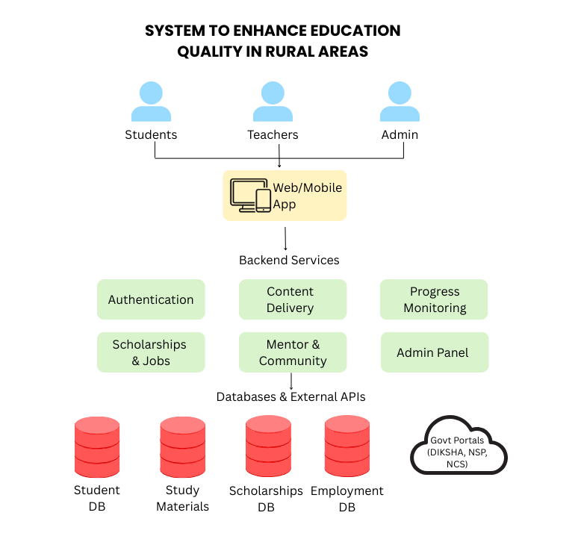
Architecture Diagram

Slide 10
Modules
User Module
  Student/Teacher/Parent registration & login
  Profile management (supports local languages)
Study Material Module
  Provides digital resources (PDFs, videos, quizzes)
  Multilingual support with offline access option
Skill Progress & Monitoring Module
  Tracks student learning progress & communication skills
  Displays analytics dashboard for performance
Scholarship & Grants Module
  Provides information on scholarships, grants, and loans
  Includes eligibility criteria and deadlines
Employment & Opportunities Module
  Shares job and internship opportunities
  Career guidance and training programs
Mentor & Community Module
  Connects students with mentors for guidance
  Peer-to-peer discussions and knowledge sharing

Slide 11
Algorithms
Authentication Algorithm (bcrypt)
Purpose: Securely verify user identity.
Use: Protects all accounts (student, teacher, admin).
Role-Based Access Control (RBAC)
Purpose: Ensure users access only what is allowed.
Use: Separates privileges between students, teachers, and admins.
CRUD Operations
Purpose: Manage database entries (Create, Read, Update, Delete).
Use: Add courses, update student details, delete old content, view reports.
Session Management
Purpose: Keep users logged in until logout.
Use: Smooth navigation without re-login.
Search & Filtering
Purpose: Quickly find content or users.
Use: Helps in managing large content.

Slide 12
Hardware and Software Requirements
Hardware Requirements
Processor: Intel i5 / AMD Ryzen 5 or higher
RAM: 8 GB or more
Storage: 256 GB SSD
OS: Windows 10 / Linux / macOS
Software Requirements
Frontend (User Interface):HTML5, CSS3, JavaScript, Tailwind CSS, React.js
Backend (Server & API): Node.js + Express.js
Database: MongoDB (NoSQL)
External APIs & Services: Google Meet API, Google Translate API
Hosting & Deployment: GitHub, Netlify, Render

Slide 13
Innovation or Novel Contributions
Our system is unique because it:
Brings everything into one platform – learning materials, mentorship, skill tracking, and career resources are all in one place.
Supports multiple Indian languages – making learning easier and more inclusive for rural students.
Provides personalized suggestions – uses basic AI logic to recommend study materials based on student progress.
Connects learners with real mentors – for guidance, motivation, and career advice.
Includes career and scholarship information – so students can find opportunities beyond academics.
Works in low internet areas – offline access to study materials ensures no student is left out.

Slide 14
Git-hub Link
https://github.com/imrxnsk/SmartEduRural.git

Slide 15
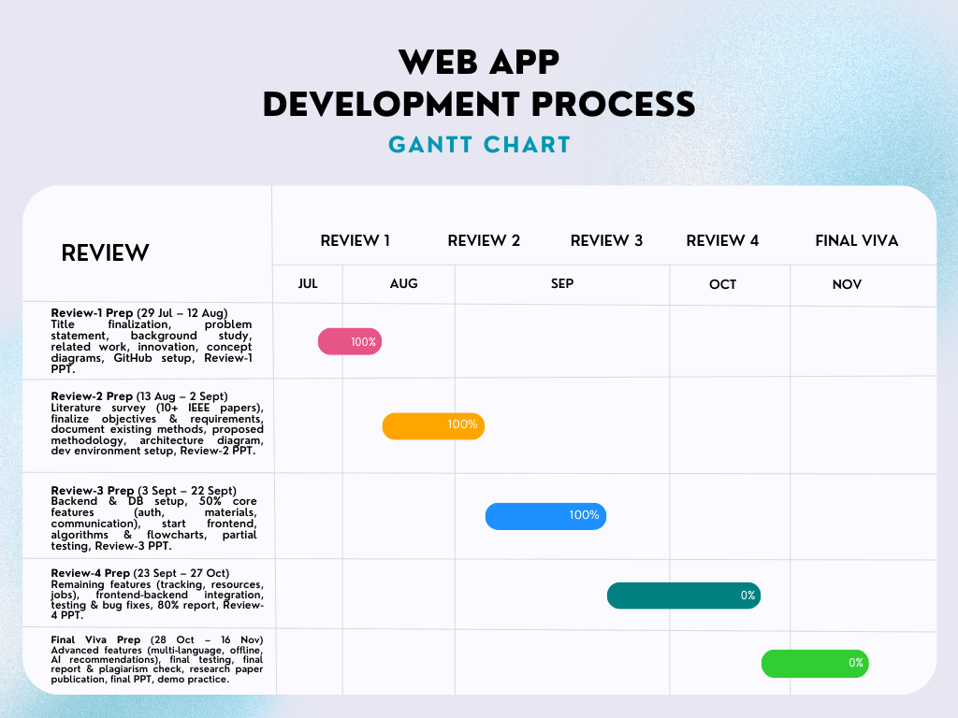
Timeline of the Project (Gantt Chart)

Slide 16
Result
Successfully developed a Smart Education System.
Built a responsive and user-friendly frontend using React, Vite, and Tailwind CSS.
Implemented key modules:
Login / Registration for students, mentors and parents.
Study Materials – students can view and download learning content in local languages.
Scholarship and Job opportunities Listings – students can view available opportunities.
Student Progress Tracking – students can track their learning progress.

Slide 17
References (IEEE Paper format)
1] A. Bardia and A. Agrawal, “MindCraft: Revolutionizing Education through AI-Powered Personalized Learning and Mentorship for Rural India,” arXiv preprint arXiv:2502.05826, Feb. 2025.
[2] Aashish Jain and Rohit Khokher, “Technologies for Quality and Sustainable Online Education in Rural India: A Comprehensive Review,” in Kaleidoscope: ITU Academic Conference, 2024.
[3] R. Vaidehi, A. Bheemeshwar Reddy, and S. Banerjee, “Explaining Caste-based Digital Divide in India,” arXiv preprint arXiv:2106.15917, Jun. 2021.
[4] S. Hussain, Z. Wang, and S. Rahim, “E-learning Services for Rural Communities,” arXiv preprint arXiv:1308.4820, Aug. 2013.
[5] N. Singh, S. Singh, B. Goswami, S. Kumar, and B. Kumar, “Bridging the Digital Divide: A Comprehensive Analysis of ICT Infrastructure in Rural Schools of Jharkhand, India,” Educational Administration: Theory and Practice, vol. 30, no. 6, pp. 4456–4460, Jun. 2024.
[6] Y. Yu, D. Appiah, B. Zulu, and K. A. AduPoku, “Integrating Rural Development, Education, and Management: Challenges and Strategies,” 2024.
[7] X. Wang, G. W. Young, M. Z. Iqbal, and C. Mc Guckin, “The potential of extended reality in rural education’s future – perspectives from rural educators,” 2024.
[8] P. D. Maheshwari, “Digital intervention in elementary education: Analysing the implementation of NEP 2020 in rural India,” 2024.
[9] M. T. K. Farooqi, I. Amanat, and M. Awan, “Ethical considerations and challenges in the integration of artificial intelligence in education: A systematic review,” Sep. 15, 2024.
[10] Y. Lin, “Application and challenges of computer networks in distance education,” 2024.

Slide 18
References (IEEE Paper format)(contd...)
[11] O. Darojat, A. Sudrajat, Darsiharjo, L. D. Ningtyas, and C. Kustandi, “Implementation of learning media usedbystudents in rural areas: A mixed-method study,” 2025.
[12] A. Zulfiqar, M. Bilal, and M. N. Iqbal, “Identification of factors affecting the quality of education in ruralareas’elementary schools,” 2024.
[13] C. Wang, “Rural education development and reform: Implementation of quality education and innovation intheeducation system,” 2024.
[14] R. Kapur, “Understanding education system in rural communities,” 2022.
[15] K. S. Suryanarayana, V. S. P. Kandi, G. Pavani, A. S. Rao, S. Rout, and T. S. R. Krishna, “Artificial intelligenceenhanceddigital learning for the sustainability of education management system,” 2024.
[16] Y. Sun et al., “Who changed the destiny of rural students, and how?: Unpacking ICT-mediated remoteeducation inrural China,” 2024.
[17] S. M. Singh, S. K. Garg, A. Misra, A. Seth, and T. Chakraborty, “SUKHSANDESH: An avatar therapeuticquestionanswering platform for sexual education in rural India,” 2024.
[18] T.-H. Hsieh and X. Lai, “Analyzing rural online education talent development with data and machinelearning,” 2024.
[19] Multiple authors, “Research on the status quo of rural teaching based on generative artificialintelligence,”2024/2025.
[20] A. Bardia and A. Agrawal, “MindCraft: Revolutionizing education through AI-powered personalized learningandmentorship for rural India,” 2025.

Slide 19


